Slide 1
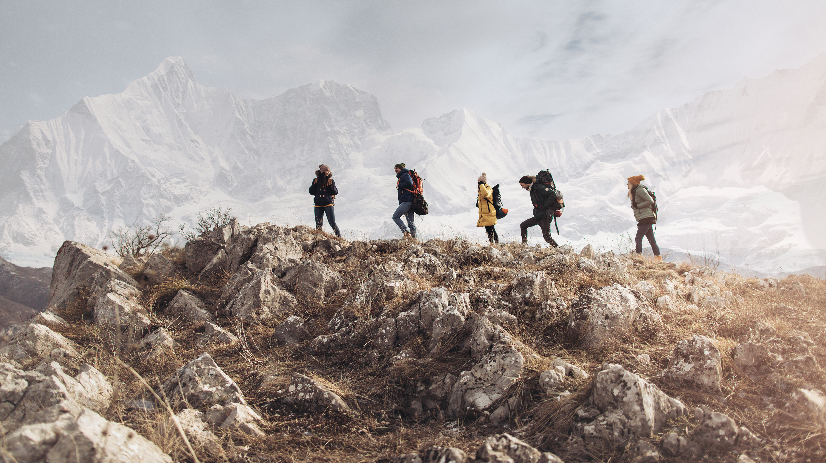
Jewish Travel: Shiur 2

Slide 2
Blessing our Study ogether
בָּרוּךְ אַתָּה יְהֹוָה אֱלֹהֵֽינוּ מֶֽלֶךְ הָעוֹלָם אֲשֶׁר קִדְּ֒שָֽׁנוּ בְּמִצְוֹתָיו וְצִוָּנוּ לַעֲסֹק בְּדִבְרֵי תוֹרָה:
Blessed are You, Adonai, Ruler of the Universe, Who sanctifies us with mitzvot and commands us to be engrossed in the words of Torah.

Slide 3
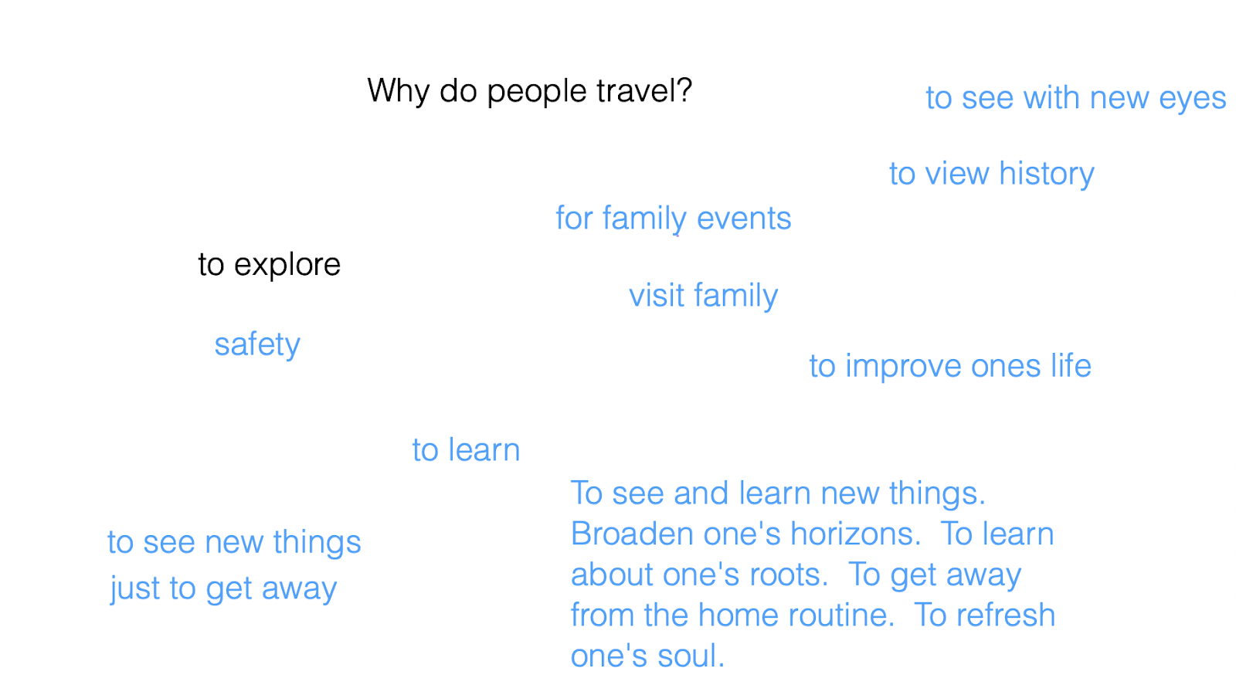
Purposes of travel
From last week
What we thought was the purpose of travel
Pilgrimages- Miraculous and Mourning
Where did people go?
Back to Jerusalem, to the temple
Places that connected to their identity and past

Slide 4
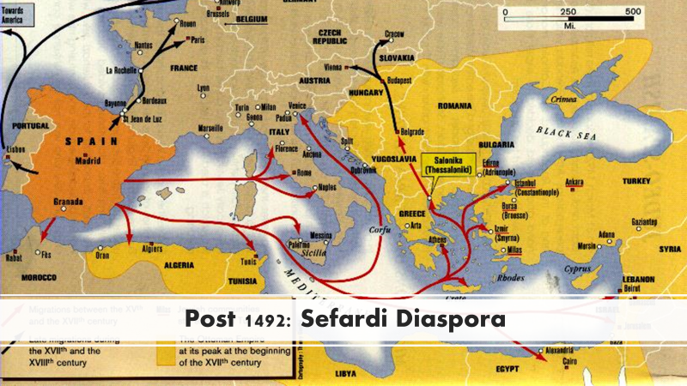
Notes:
Travel bc Jews were forced out… but that resulted in a great amount of cultural spread and shifts

Slide 5
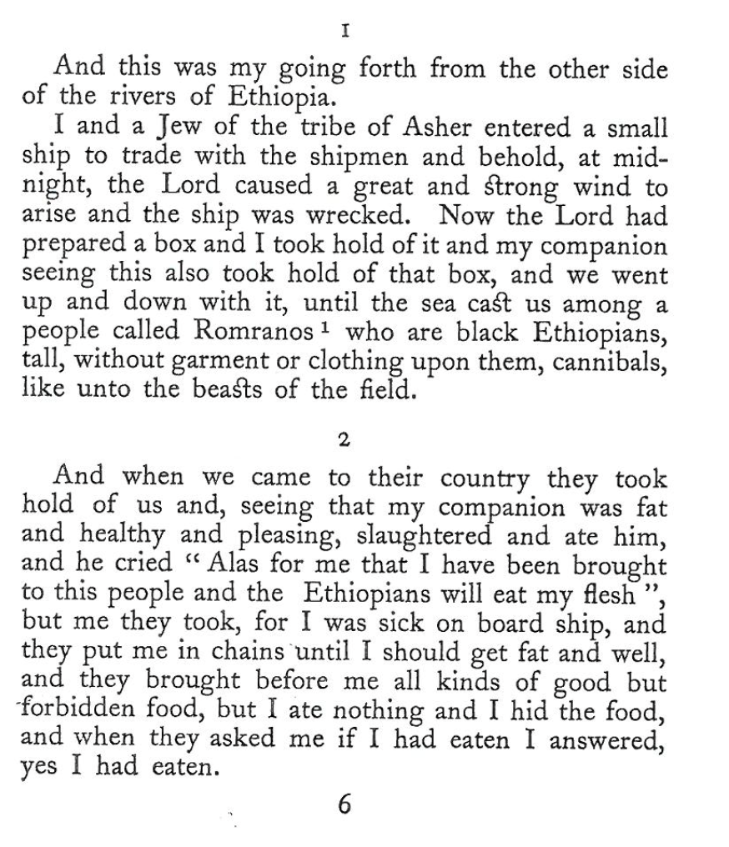
Sephard: Eldad the Danite (880)
Notes:
Jewish merchant, Explorer and scholar of languages
from the tribe of Dan, from east of Africa, near the gulf of aden (today between yemen and Somalia)
Jewish traveller and philologist who was generally credited with the authorship of a fanciful geographical narrative that exerted an enduring influence throughout the Middle Ages. This possibly gave rise to the legend of Prester John, the mighty Oriental priest-potentate of fabulous wealth and power.
Probably originally from southern Arabia, Eldad visited Mesopotamia, Egypt, North Africa, and Spain and caused a stir by his account of the Ten Lost Tribes of Israel. He himself claimed to be a descendant of the Danites, who, together with the tribes of Naphtali, Asher, and Gad, were said to have established a Jewish kingdom in Cush (Kush), variously interpreted as Ethiopia or, roughly, present-day Sudan. His veracity was challenged largely because the ritual prescriptions he described diverged from those of the Talmud, the rabbinical compendium of law, lore, and commentary. His Hebrew narrative, Sefer Eldad, established his reputation as a philologist whom leading medieval Jewish grammarians and lexicographers quoted as an authority on linguistic difficulties. It appeared in several languages and in widely deviating versions. The first edition was published at the Italian city of Mantua in 1480.
https://www.britannica.com/biography/Eldad-ben-Mahli-ha-Dani

Slide 6
Sephard: Eldad the Danite (880)

Slide 7
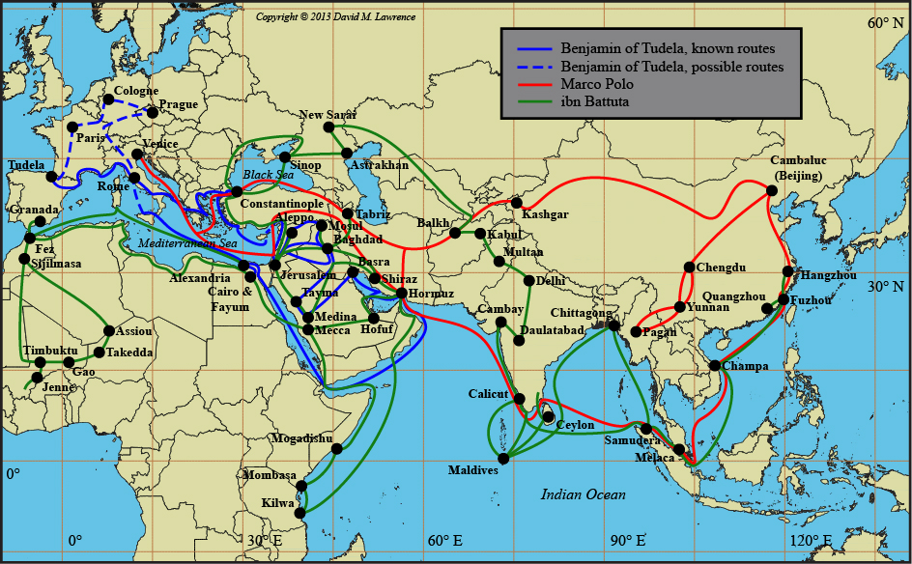
Notes:
Benjamin traveled actually about 100 years before marco polo
Marco polo- venetian merchant and exploere 13th century
Ibn Battuta0- berber mahgrebi scholar and explora (14th century)
a medieval Jewish traveler who visited Europe, Asia, and Africa in the 12th century. His vivid descriptions of western Asia preceded those of Marco Polo by a hundred years. With his broad education and vast knowledge of languages, Benjamin of Tudela is a major figure in medieval geography and Jewish history.
Little is known of his early life, apart from the fact that he was from the Navarrese town of Tudela in what is now Spain.^{[1]} Today, a street in the aljama (former Jewish quarter) is named after him.
He left Tudela, Spain between 1159 and 1163, and he returned in 1172. The two things we do know are that he traveled extensively for more than ten years (some historians believe fourteen years) visiting Jewish and non-Jewish communities around the world, and he wrote about his experiences. His travel diary, the Book of Travels, has been a god-send for historians.
He indicates the distances between the various towns he visited, tells who stood at the head of the Jewish communities, and who were the most notable scholars. He gives the number of Jews he found in each place, though it is not clear in many instances whether he is speaking of individuals or of householders, and in some cases such as Baghdad, the figures seem to be exaggerated.
https://www.jewishvirtuallibrary.org/benjamin-of-tudela

Slide 8
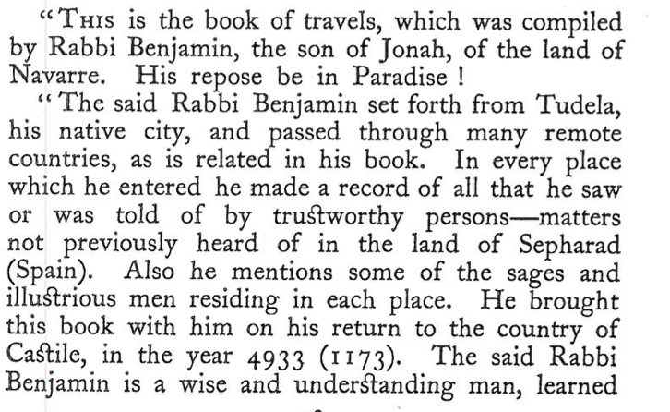
Sephard: Benjamin of Tudela (1165-73)
Notes:
a medieval Jewish traveler who visited Europe, Asia, and Africa in the 12th century. His vivid descriptions of western Asia preceded those of Marco Polo by a hundred years. With his broad education and vast knowledge of languages, Benjamin of Tudela is a major figure in medieval geography and Jewish history.
Little is known of his early life, apart from the fact that he was from the Navarrese town of Tudela in what is now Spain.^{[1]} Today, a street in the aljama (former Jewish quarter) is named after him.
He left Tudela, Spain between 1159 and 1163, and he returned in 1172. The two things we do know are that he traveled extensively for more than ten years (some historians believe fourteen years) visiting Jewish and non-Jewish communities around the world, and he wrote about his experiences. His travel diary, the Book of Travels, has been a god-send for historians.
He indicates the distances between the various towns he visited, tells who stood at the head of the Jewish communities, and who were the most notable scholars. He gives the number of Jews he found in each place, though it is not clear in many instances whether he is speaking of individuals or of householders, and in some cases such as Baghdad, the figures seem to be exaggerated.
https://www.jewishvirtuallibrary.org/benjamin-of-tudela

Slide 9
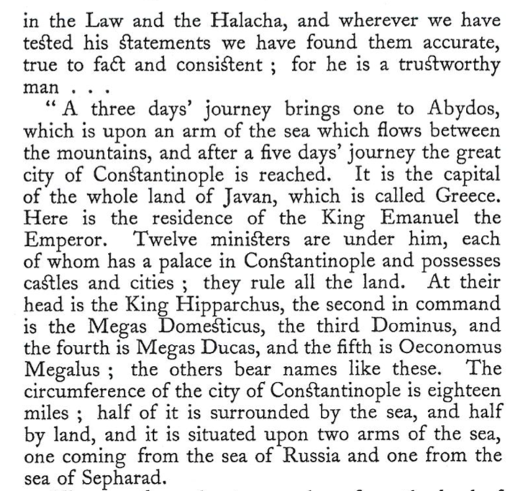
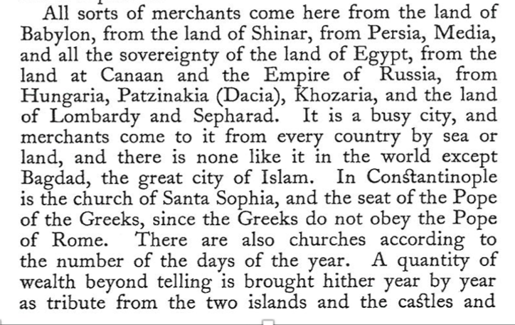
Sephard: Benjamin of Tudela (1165-73)

Slide 10
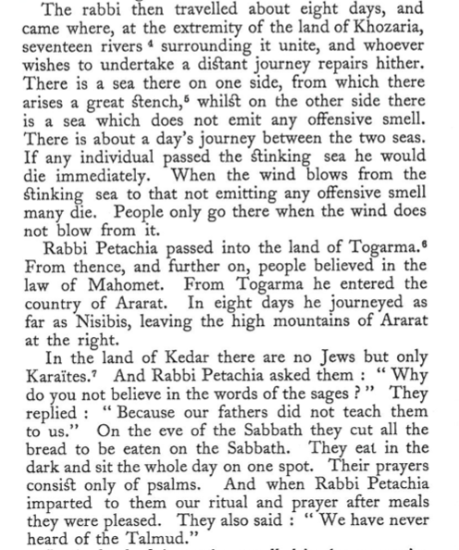
Sephard: Rabbi Petachia of Ratisbon (1170-87)
Notes:
Petachiah was born in Ratisbon/Regensburg in Bavaria, and later lived in Prague. His entire family were judges or Talmudic scholars
He traveled not long after Benjamin of Tudela so his account of similar communities and groups such as the karaites, helped affirm and cement certain things as facts
Petachiah travelled east from Bohemia through Poland, Ruthenia, southern Ukraine (which he called Kedar), and the Crimean Gazaria (Genoese colonies). He describes the remnants of the Khazars and the early Crimean Karaite community. He then went south through the Kipchak khanates and the Caucasus into Armenia, sojourning for a while in Nisibis. From there he travelled to Mesopotamia, visiting Nineveh, Sura, Pumbedita, and Baghdad before moving on to Persia. Turning westward, he journeyed up the Euphrates and into Syria, visiting Aleppo and Damascus. He travelled onward to the Kingdom of Jerusalem, visiting holy sites in the Galilee and Judea, whence he may have taken to the sea. The next place he describes is Greece. From there, presumably, he returned home via the Balkans.
His travel stories can still be purchased today: https://www.amazon.com/Travels-Rabbi-Petachia-Ratisbon-Civilization/dp/1611439116
Note- karaties- strictly follow the written Torah and uses that as halakha, so no rabbinic Judaism. Still around today mostly in Israel and small minority in US and Ukraine

Slide 11
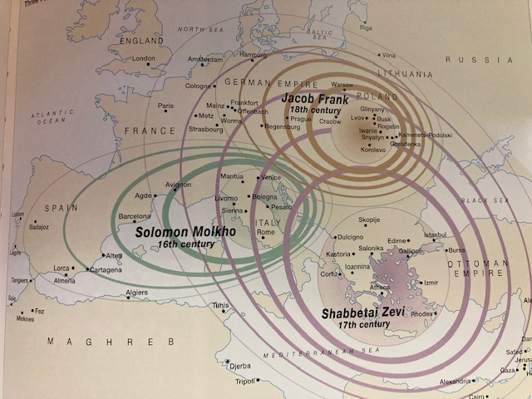
Ashkenaz: The spread of people and Ideas
A period of Jewish Messianism in response to changes in beliefs

Slide 12
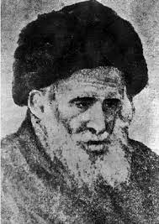
Ashkenaz: Hassidism
Jewish life in western Europe was focused in major cities, much of life in Eastern Europe was based in smaller close-knit communities- shtetls
With new ideas and charismatic leaders, people traveled to these leaders, their centers, and brought their ideas with them
Baal Shem Tov (the BeShT) is the founder but the Dov Ber (the Maggid) of Mezeritch made it into a movement

Slide 13
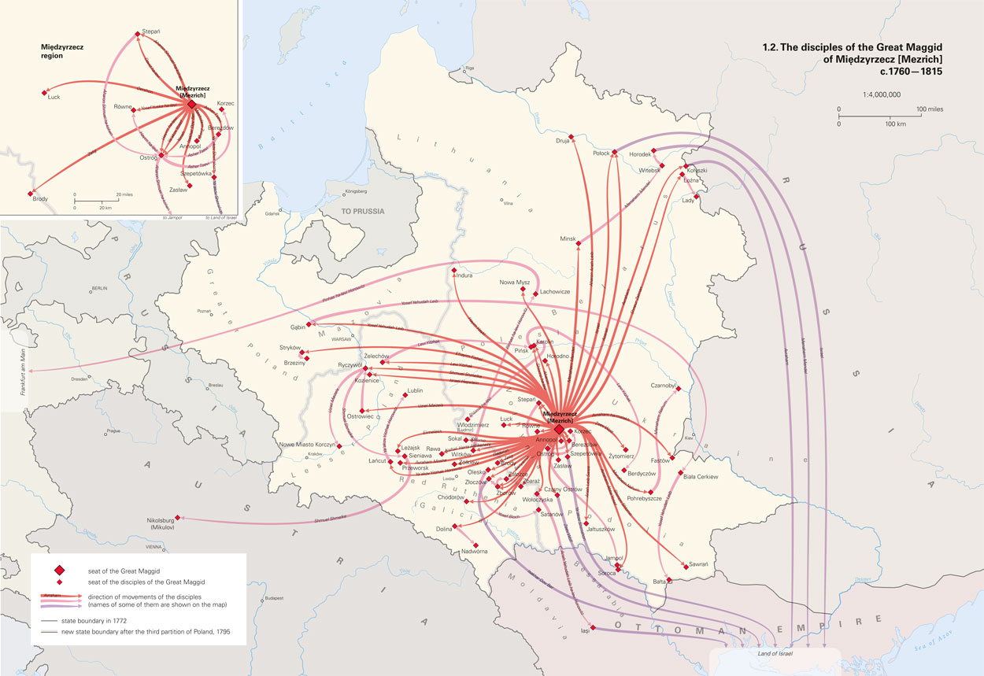

Slide 14
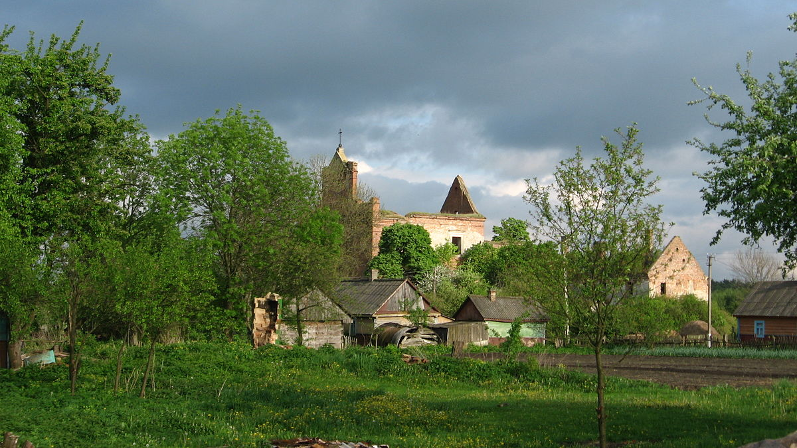
Stories from Mezeritch
“What did you learn from Mezeritch?” Rebbe Aharon of Karlin was asked- “Nothing at all” – “what do you mean?” “yes, in Mezeritch I learned that I am nothing at all”
“And you?” Rebbe Levi- Yitzhak of Berditchev was asked. “what did you discover from the Great Maggid’s school?” -“I discovered that God exists, that He is of this world, of all worlds.”- “But Rebbe, everybody knows that!” –”No. They say it everywhere, but in Mezeritch they know it”
“A third Hasidic Master, Rebbe Shmelke of Nikolsburg, testified in his own way: “A long time ago, in the blindness of my youth, I mortified my body so it would tolerate my soul. Since Mezeritch, I know that cannot be right. Body and soul must and can live in harmony.” Souls on Fire, p56)
“Elsewhere, among the poverty stricken tribes of Galicia, the task of the Maggid’s emissaries was to bring hope and consolation to people living in despair and humiliation. To upset the established order, rock the institutions, tear down the barriers separating poor and rich, scholar and craftsman, peasant and townsman. And above all, to show that to be Jewish could ne a link, a faith in new beginnings.” (Souls on Fire, p65-66)

Slide 15
What happens after this age of Rebbes and leaders?
A new type of Pilgrimage or an old one?
Visiting the sites of great sages
Lag B’Omer – in Israel (Meron), in Ukraine, and in Morocco

Slide 16
New purposes for travel? And Next time….

